Slide 1
Single Page Applications and Routing
Getting started with SPAs and routing
Parameterized routes
Nested routes
Descendant routes

Slide 2
Section 1: Getting Started with SPAs and Routing
Overview
Supporting routing in React
Defining a router table
Defining a menu

Slide 3
Overview
React has excellent support for implementing SPAs
Define an App component that always remains resident
Define multiple sub-components, which can be swapped in and out of the App component
Each sub-component maps to a logical URL
This is called routing
To display a different sub-component in the browser, simply navigate to the URL for that sub-component

Slide 4
Supporting Routing in React
Add these dependencies in package.json:
Wrap your App component in <BrowserRouter>:
React Router
"dependencies": {
"react-router-dom": "^6.3.0",
"@types/react-router-dom": "^5.3.3",
…
}
React Router TypeScript declarations
package.json
import { BrowserRouter } from 'react-router-dom';
…
root.render(
<React.StrictMode>
<BrowserRouter>
<App />
</BrowserRouter>
</React.StrictMode>
);
index.tsx

Slide 5
Defining a Router Table
Define a router table as follows, typically in App:
import { Routes, Route } from 'react-router-dom';
…
function App() {
return (
…
<Routes>
<Route path="/" element={<Home/>} />
<Route path="/about" element={<About/>} />
<Route path="/contact" element={<Contact/>} />
<Route path="*" element={<PageNotFound/>} />
…
</Routes>
…
);
}
App.tsx

Slide 6
Defining a Menu
It's common to define some kind of menu component
Use <NavLink> to create links to your routes
You typically display the menu in your App component
import { NavLink } from "react-router-dom";
…
function Menu() {
return (
<nav>
<NavLink to="/">Home</NavLink>&nbsp;|&nbsp;
<NavLink to="/contact">Contact</NavLink>&nbsp;|&nbsp;
<NavLink to="/about">About</NavLink>&nbsp;|&nbsp;
…
</nav>
)
}
Menu.tsx

Slide 7
Section 2: Parameterized Routes
Overview
Understanding the data model
Defining parameterized routes
Rendering parameterized links
Obtaining path parameters
Programmatic navigation

Slide 8
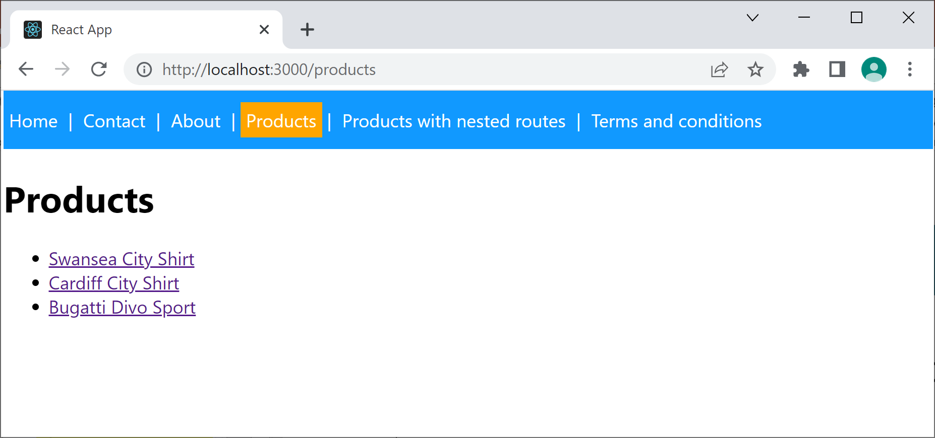
Overview
React router lets you define parameterized routes
E.g., /product/:id
The demo app illustrates parameterized routes
/product/1
/product/2
/product/3
8

Slide 9
Understanding the Data Model
To understand the demo, the first stop is to consider the data model
See Catalog.ts, which defines 2 simple classes:
ProductItem - Represents a simple product item
Catalog - Contains hard-coded product items
9

Slide 10
Defining Parameterized Routes
Here's the relevant part of the route table
/products - Display all product items
/product/:id - Display product item with specified id
<Routes>
…
<Route path="/products" element={<Products/>} />
<Route path="/product/:id" element={<Product/>} />
…
</Routes>
App.tsx
10

Slide 11
Rendering Parameterized Links
Products.tsx renders parameterized links like so:
function Products() {
let products = Catalog.getAllProductItems()
return (
<div>
<h1>Products</h1>
<ul>
{
products.map((p, i) =>
<li key={i}>
<Link to={`/product/${p.id}`}>{p.description}</Link>
</li>
)
}
</ul>
</div>
)
}
Products.tsx
11

Slide 12
Obtaining Path Parameters
ProductV1.tsx obtains path parameters like so:
import { useParams } from "react-router-dom";
…
function Product() {
let { id } : any = useParams()
let prod = Catalog.getProductItemById(id)
if (!prod) {
…
}
else {
return (
<div>
<h1>Product details</h1>
<div>Description: {prod.description}</div>
<div>Price: {prod.price}</div>
<div>Likes: {prod.likes}</div>
<div>Most recent like: {prod.mostRecentLike}</div>
</div>
)
}
}
ProductV1.tsx
12

Slide 13
Programmatic Navigation
We've seen how to navigate to a route via a <Link>
You can also navigate to a route programmatically
For an example, see ProductV2.tsx
<Link to='somePath'>Click me</Link>
import {useNavigate } from "react-router-dom";
…
function SomeComponent() {
let navigate = useNavigate();
navigate(somePath);
…
}
13

Slide 14
Section 3: Nested Routes
Overview
Implementing the outer route
Implementing an index route
Implementing a nested route
Implementing another nested route

Slide 15
Overview
React router lets you define nested routes
The user can navigate to the following routes:
/products-with-nested-routes
/products-with-nested-routes/1 (etc.)
/products-with-nested-routes/summary
<Routes>
…
<Route path="/products-with-nested-routes" element={<ProductsWithNestedRoutes/>}>
<Route index element={<ProductUnselected/>} />
<Route path=":id" element={<Product/>} />
<Route path="summary" element={<ProductSummary/>} />
</Route>
…
</Routes>
App.tsx
15

Slide 16
Implementing the Outer Route
Let's consider the outer route:
When we go to /products-with-nested-routes
ProductsWithNestedRoutes component is rendered
Contains an <Outlet/>, to house a nested component
<Routes>
…
<Route path="/products-with-nested-routes" element={<ProductsWithNestedRoutes/>}>
<Route index element={<ProductUnselected/>} />
<Route path=":id" element={<Product/>} />
<Route path="summary" element={<ProductSummary/>} />
</Route>
…
</Routes>
App.tsx
16

Slide 17
Implementing an Index Route
We've defined an index route as follows:
Indicates the default component to render in <Outlet/> if the user navigates just to the parent route
ProductUnselected component is rendered
<Routes>
…
<Route path="/products-with-nested-routes" element={<ProductsWithNestedRoutes/>}>
<Route index element={<ProductUnselected/>} />
<Route path=":id" element={<Product/>} />
<Route path="summary" element={<ProductSummary/>} />
</Route>
…
</Routes>
App.tsx
17

Slide 18
Implementing a Nested Route
We've defined a nested route to display one product:
Go to /products-with-nested-routes/1
ProductsWithNestedRoutes component is rendered
In its <Outlet/>, Product component is rendered
<Routes>
…
<Route path="/products-with-nested-routes" element={<ProductsWithNestedRoutes/>}>
<Route index element={<ProductUnselected/>} />
<Route path=":id" element={<Product/>} />
<Route path="summary" element={<ProductSummary/>} />
</Route>
…
</Routes>
App.tsx
18

Slide 19
Implementing another Nested Route
We've defined another nested route as follows:
Go to /products-with-nested-routes/summary
ProductsWithNestedRoutes component is rendered
In its <Outlet/>, ProductSummary component is rendered
<Routes>
…
<Route path="/products-with-nested-routes" element={<ProductsWithNestedRoutes/>}>
<Route index element={<ProductUnselected/>} />
<Route path=":id" element={<Product/>} />
<Route path="summary" element={<ProductSummary/>} />
</Route>
…
</Routes>
App.tsx
19

Slide 20
Section 4: Descendant Routes
Overview
Example
Defining descendant routes
Navigating to descendant routes

Slide 21
Overview
React router lets you define descendant routes
In a high-level component (e.g. App), define parent routes
In a low-level component, define descendant routes
This promotes modularity
The high-level component doesn't need to know about the details of low-level routes
21

Slide 22
Example
Consider the following parent route, defined in App:
The * at the end of the path is important
If you navigate to /ts-and-cs/anything
… then the TsAndCs component will be rendered
The TsAndCs component defines descendant routes
See next slide
<Routes>
…
<Route path="/ts-and-cs/*" element={<TsAndCs/>} />
…
</Routes>
App.tsx
22

Slide 23
Defining Descendant Routes
The TsAndCs component defines descendant routes
These routes are relative to the parent route
function TsAndCs() {
return (
<Routes>
<Route path="/" element={<TsAndCsHome/>} />
<Route path="uk" element={<TsAndCsUk/>} />
<Route path="eur" element={<TsAndCsEur/>} />
<Route path="apac" element={<TsAndCsApac/>} />
<Route path="*" element={<TsAndCsRow/>} />
</Routes>
)
}
TsAndCs.tsx
23

Slide 24
Navigating to Descendant Routes
Try navigating to the following routes:
/ts-and-cs/
/ts-and-cs/uk
/ts-and-cs/eur
/ts-and-cs/apac
/ts-and-cs/wibble
Discuss 😃
24

Slide 25
Summary
Getting started with SPAs and routing
Parameterized routes
Nested routes
Descendant routes

